Slide 1
Microsoft .NET

Slide 2
Course Contents
Vision of .NET
Introduction to .NET
.NET Architecture
.NET Framework Architecture
Advantages of .NET
CLR
Execution of .NET application
MSIL
Intro ASP.NET,C#,VisualBasic.NET,ADO.NET
NET Enterprise Servers

Slide 3
Vision of .NET
Integration of data across different devices and systems no matter
on which device or operating system they are running on
Internet + Operating = Internet Operating System
Concept of Web Service
Web Standards(XML + SOAP)

Slide 4
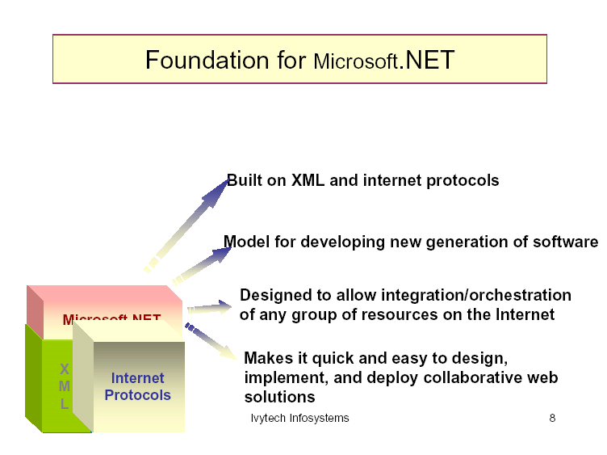

Slide 5
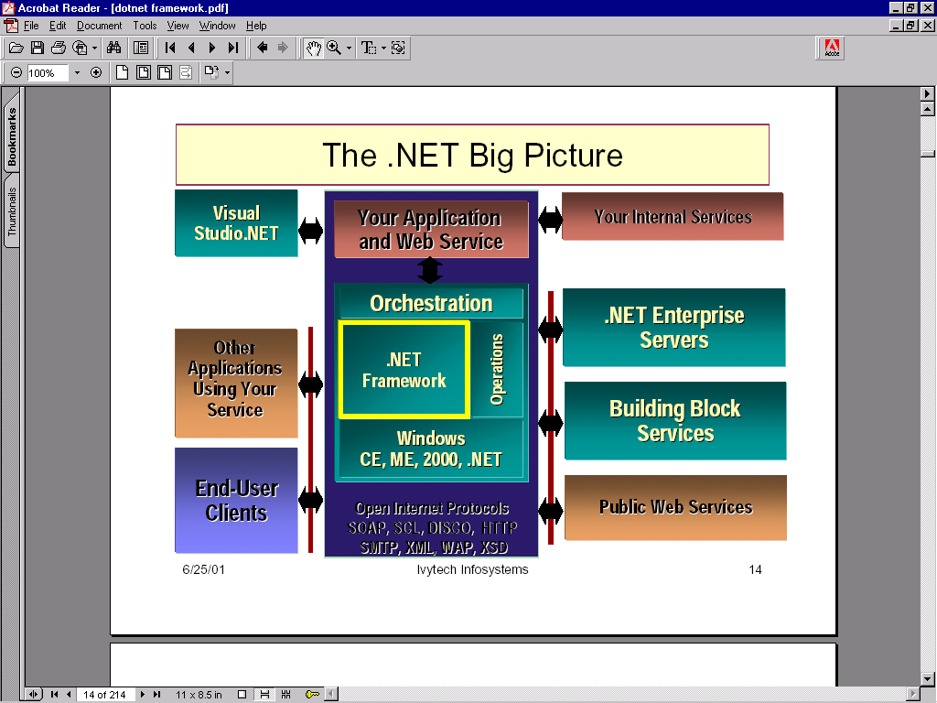

Slide 6
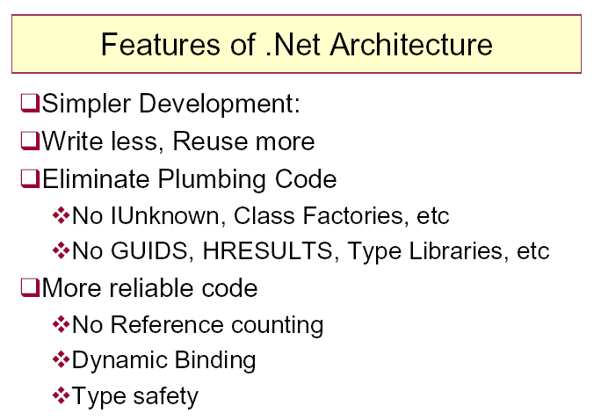

Slide 7
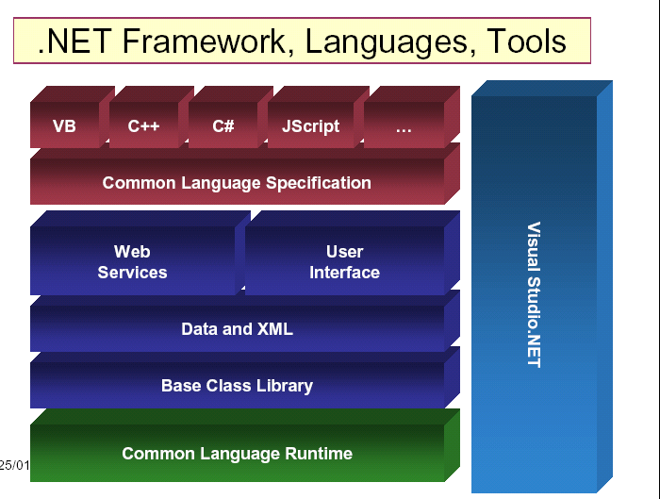

Slide 8
What is .NET Framework?
Set of Software Libraries and Development Tools that layer on the top of Windows
Designed to simplify enterprise application development
It provides the infrastructure for developing, debugging and deploying applications
It makes available a development environment that spans multiple languages

Slide 9
Advantages of .NET
Rapid Application Development
  Supports WYSIWYG editing tools and powerful RAD development tools, such as Microsoft Visual Studio.NET, for designing and programming forms
Enhanced Performance
  This is enabled by the CLR, which is available as a compiler thereby amounting to a dramatically better performance
Language Support
  Offers built-in support for C# (pronounced "C Sharp"), Visual Basic, and Jscript among other languages

Slide 10
Advantages of .NET (Contd…)
Rich set of Libraries
  The .NET Framework class library provides a comprehensive, object-oriented collection of reusable classes that can be used to develop wide-range of applications
Enhanced Security
  With built in Windows authentication and per-application configuration, you can be assured your applications are secure
Simple and Faster Deployment
  .NET application is deployed to a server simply by copying the necessary files to the server. No server restart is required, even to deploy or replace running compiled code!

Slide 11
Advantages of .Net (Contd..)
Easily compatible with ASP applications
  Developers simply need to change file extensions from .asp to .aspx to migrate their files to the ASP.NET framework
High degree of Availability
  The runtime environment closely monitors the required processes and ensures that the .NET application is constantly available to handle user requests
Powerful built-in tools
  Includes Designer, Wizard and Debugger

Slide 12
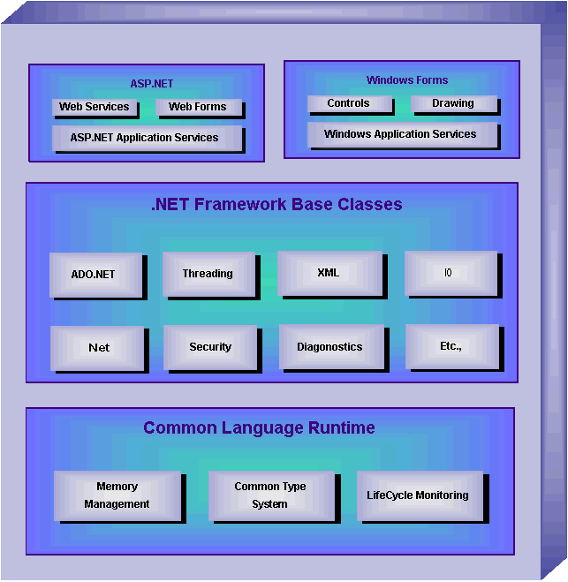
.NET framework architecture

Slide 13
CLR (Common Language Runtime)
Security API
JIT Compiler
Base Class Libraries
COM Interoperability
Assemblies
Application Domains
.exe
for vb.net,c#
MSIL
I/p
Html
for ASP

Slide 14
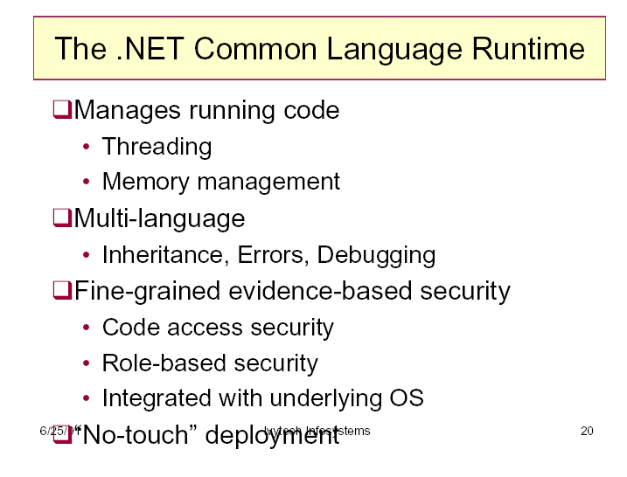

Slide 15
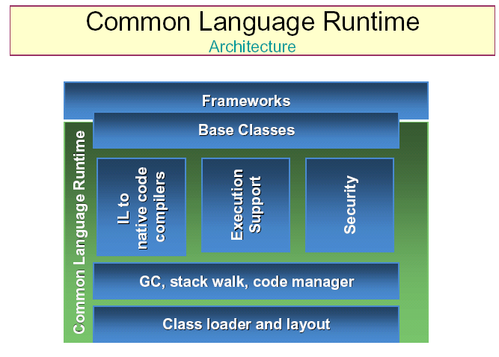

Slide 16
common language runtime
The .NET Framework provides a run-time environment called the
common language runtime, which manages the execution of code and
provides services that make the development process easier.
Compilers and tools expose the runtime's functionality and enable you to write code that benefits from this managed execution environment. Code that you develop with a language compiler that targets the runtime is called managed code; it benefits from features such as cross-language integration, cross-language exception handling, enhanced security, versioning and deployment support, a simplified model for component interaction, and debugging and profiling services.

Slide 17
Language compilers and tools expose the runtime's functionality in ways that are intended to be useful and intuitive to their developers. This means that some features of the runtime might be more noticeable in one environment than in another. How you experience the runtime depends on which language compilers or tools you use. For example, if you are a Visual Basic developer, you might notice that with the common language runtime, the Visual Basic language has more object-oriented features than before.

Slide 18
The following benefits of the runtime might be particularly interesting to you:
  Performance improvements.
  The ability to easily use components developed in other languages.
  Extensible types provided by a class library.
  New language features such as inheritance, interfaces, and overloading for object-oriented programming; support for explicit free threading that allows creation of multithreaded, scalable applications; support for structured exception handling and custom attributes.

Slide 19
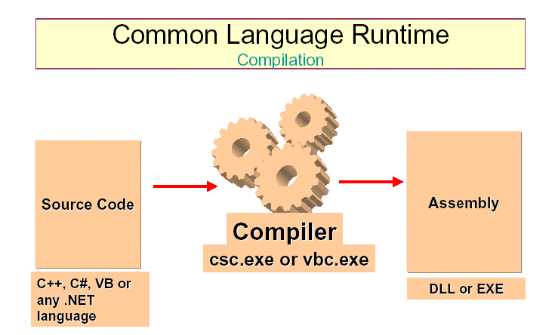

Slide 20
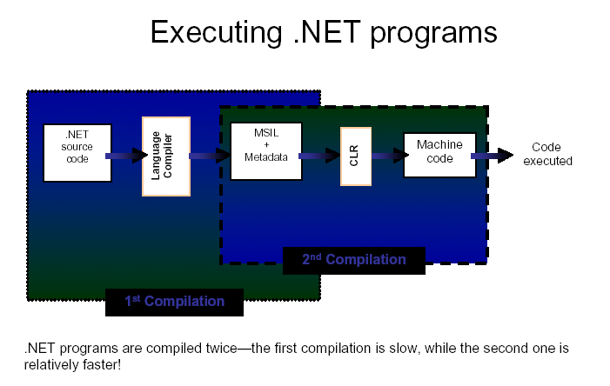

Slide 21
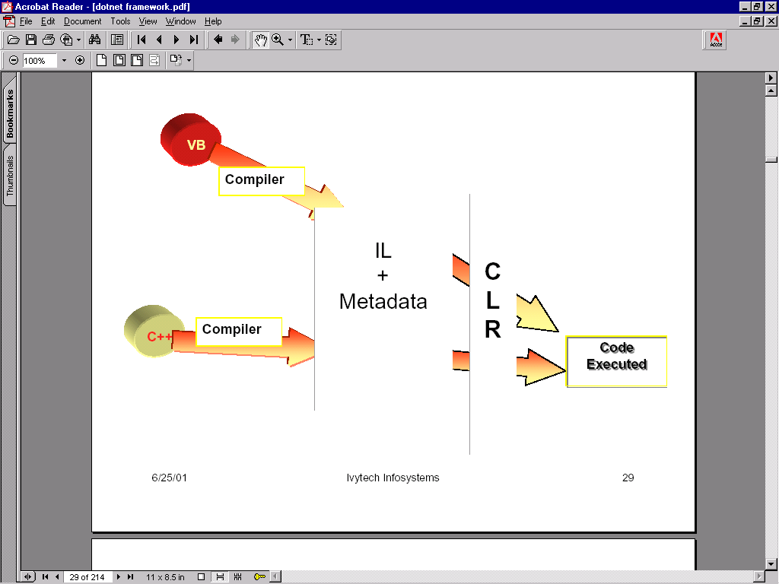

Slide 22
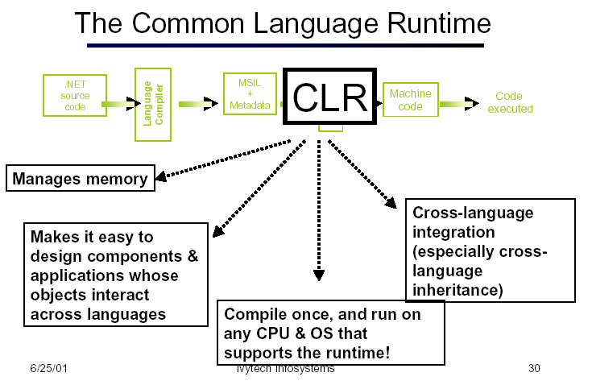

Slide 23
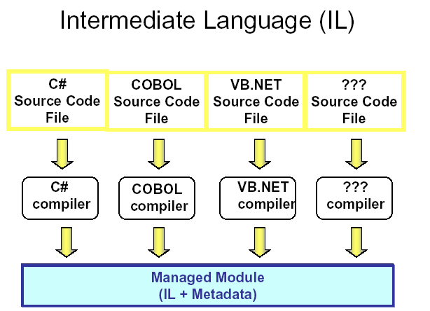

Slide 24
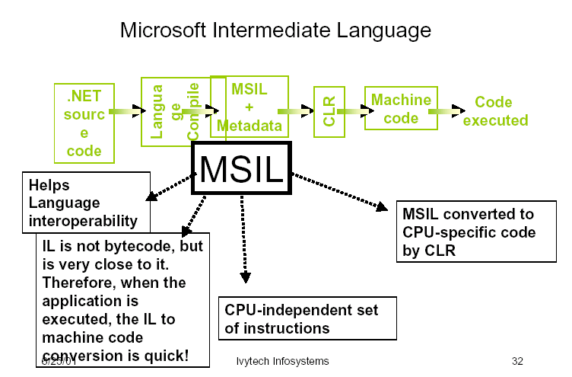

Slide 25
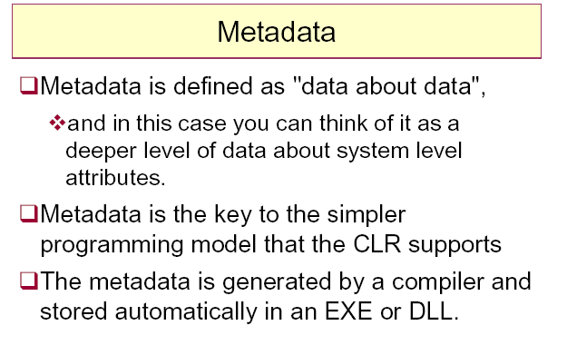

Slide 26
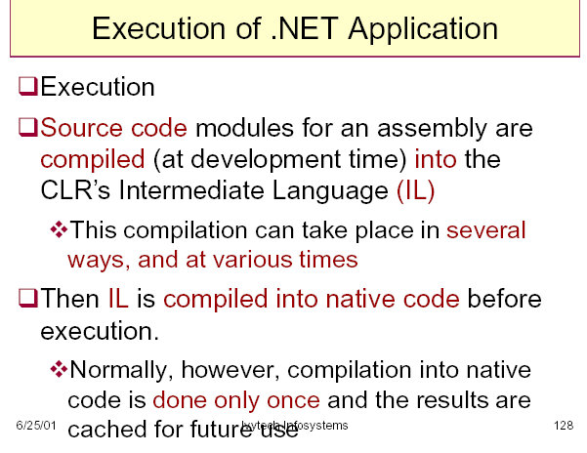

Slide 27
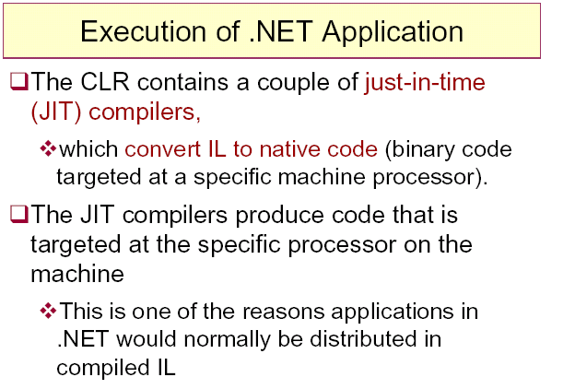

Slide 28
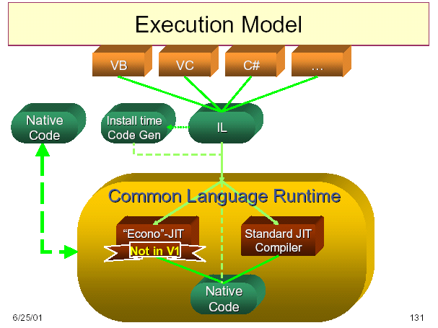

Slide 29
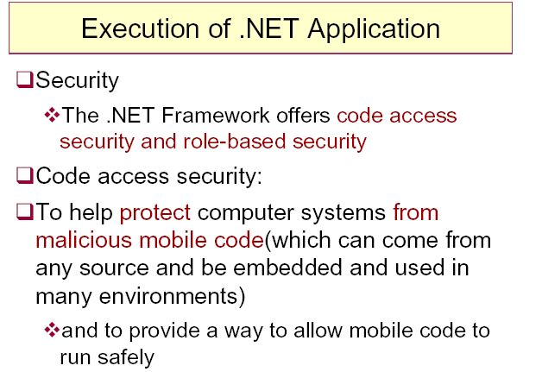

Slide 30
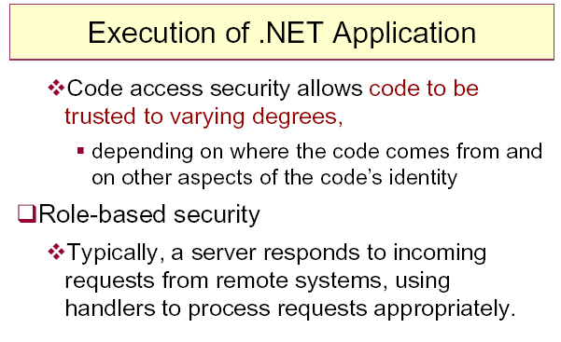

Slide 31
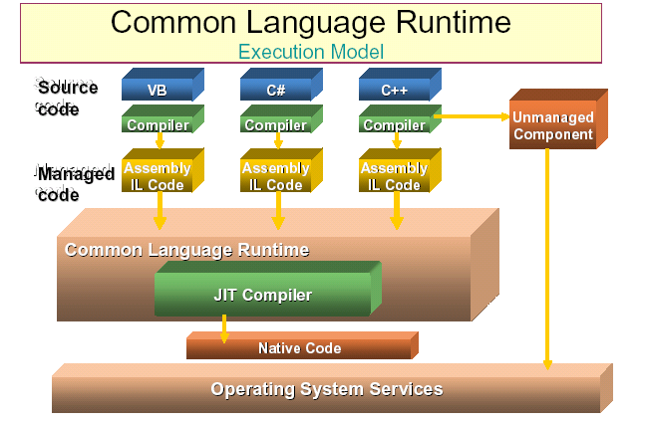

Slide 32
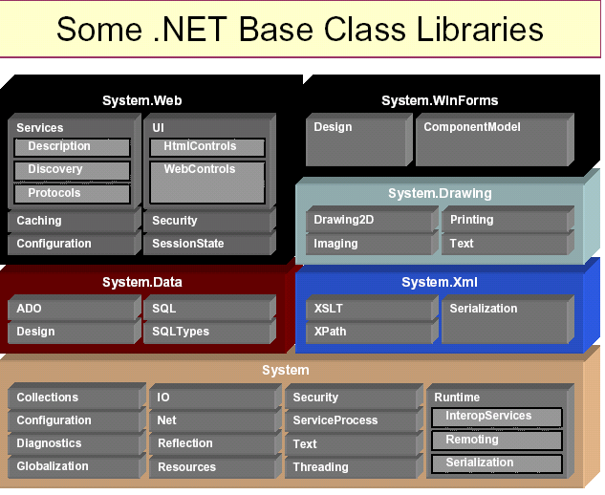

Slide 33
An overview of the .NET Application
A .net application is composed of three primary entities
Assemblies : the primary unit of deployment of a .NET application
Modules : the individual files that make up an assembly
Types : the basic units that encapsulates data and behavior
Assemblies : It is either a dynamic linked library (DLL) or an executable (EXE).
An assembly is composed of a manifest, one or mode modules and other files that
contain HTML,XML, images and so on.
Modules : A module contains Microsoft Intermediate Language (MSIL, often
abbreviated to IL) code,associated metadata. And (optionally) the assembly manifest.
Types : A type is a template that is used to describe the encapsulation of data and an
associated set of behaviors. There are two kinds of type : reference and value.

Slide 34
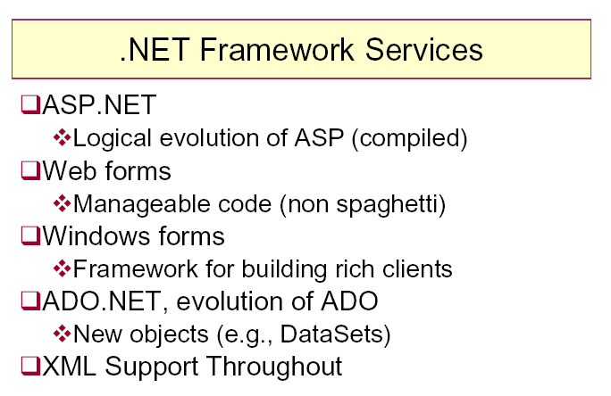

Slide 35
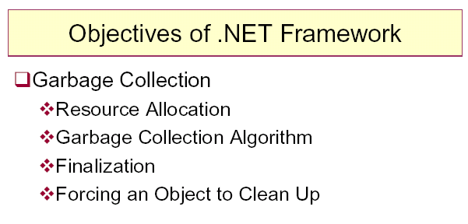

Slide 36
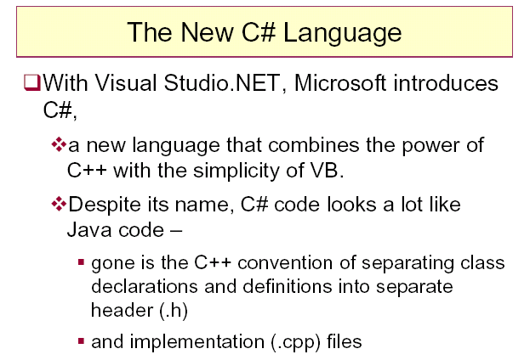

Slide 37
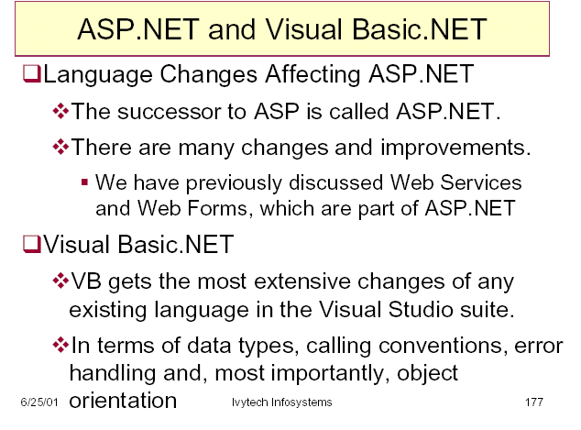

Slide 38
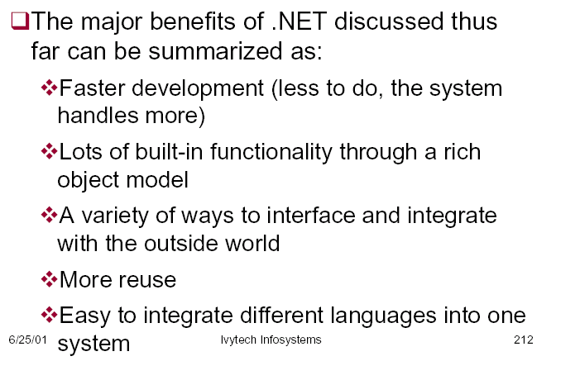

Slide 39
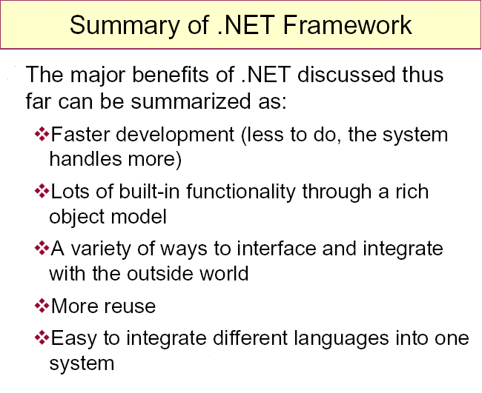

Slide 40
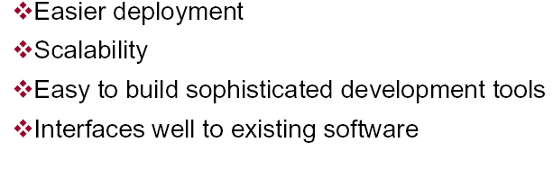

Slide 41
.NET Enterprise Servers
MS SQL Server 2000
The complete database and analysis solution for delivering scalable Web applications
Microsoft Application Center 2000
The deployment and management tool for high availability Web applications built on
Windows 2000.
Microsoft BizTalk Server 2000
BizTalk Messaging Services provides the ability to send business documents in a
secure and reliable manner. An example of such a document could be a purchase order
sent to a supplier, or a request for a price quote on the same product sent to multiple
suppliers in order to select the lowest bidder

Slide 42
Microsoft Commerce Server 2000
The solution for quickly building an effective online business.
Microsoft Exchange Server 2000
The reliable, easy to manage messaging and collaboration solution for bringing
users and knowledge together Can be used as a Mail Server Contains powerful and
in-built Workflow capabilities
Microsoft Host Integration Server 2000
To integrate with legacy systems

